Slide 1

CS 533 INTRO TO DATA SCIENCE
Michael Ekstrand

Slide 2
CORRELATION

Slide 3

Learning Outcomes
Compute correlation coefficient
Understand the relationship between covariance and correlation
Photo by Scott Webb on Unsplash

Slide 4
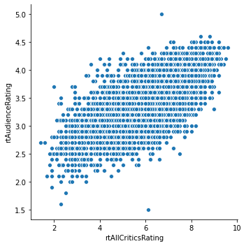

Correlation
We can see the relationship.
But how correlated are the two variables?

Slide 5


Variance
Remember this?
$$σ^{2}=\frac{∑{\left(x_{i}−μ\right)}^{2}}{n}=E\left[{\left(X−E\left[X\right]\right)}^{2}\right]$$
And standard deviation, $σ$?
How one variable varies

Slide 6


Covariance
$$Cov\left(X,Y\right)=E\left[\left(X−E\left[X\right]\right)\left(Y−E\left[Y\right]\right)\right]$$
Special case:
$$σ^{2}=Cov(X, X)$$
Measures how much data varies together!

Slide 7
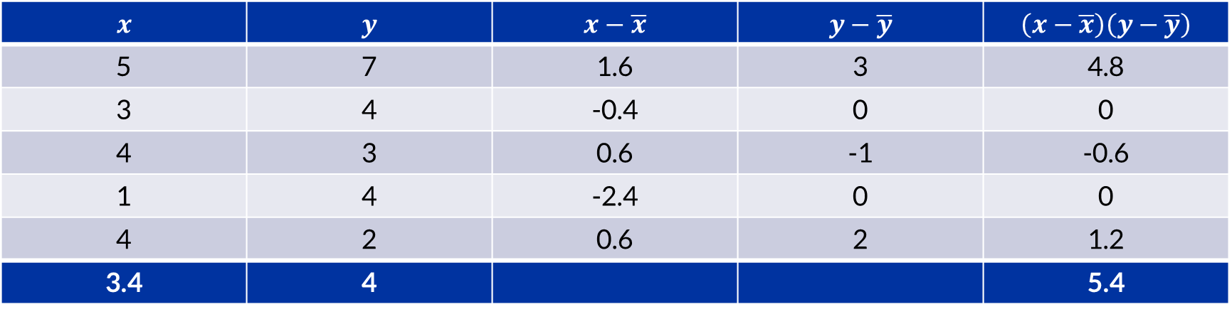
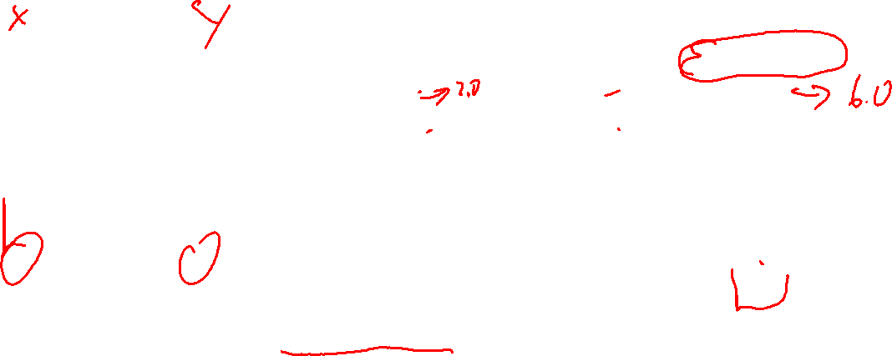
Covariance
$$x$$ | $$y$$ | $$x−\overline{x}$$ | $$y−\overline{y}$$ | $$\left(x−\overline{x}\right)\left(y−\overline{y}\right)$$
5 | 7 | 1.6 | 3 | 4.8
3 | 4 | -0.4 | 0 | 0
4 | 3 | 0.6 | -1 | -0.6
1 | 4 | -2.4 | 0 | 0
4 | 2 | 0.6 | 2 | 1.2
3.4 | 4 |  |  | 5.4
$$Cov\left(X,Y\right)=1.08$$

Slide 8
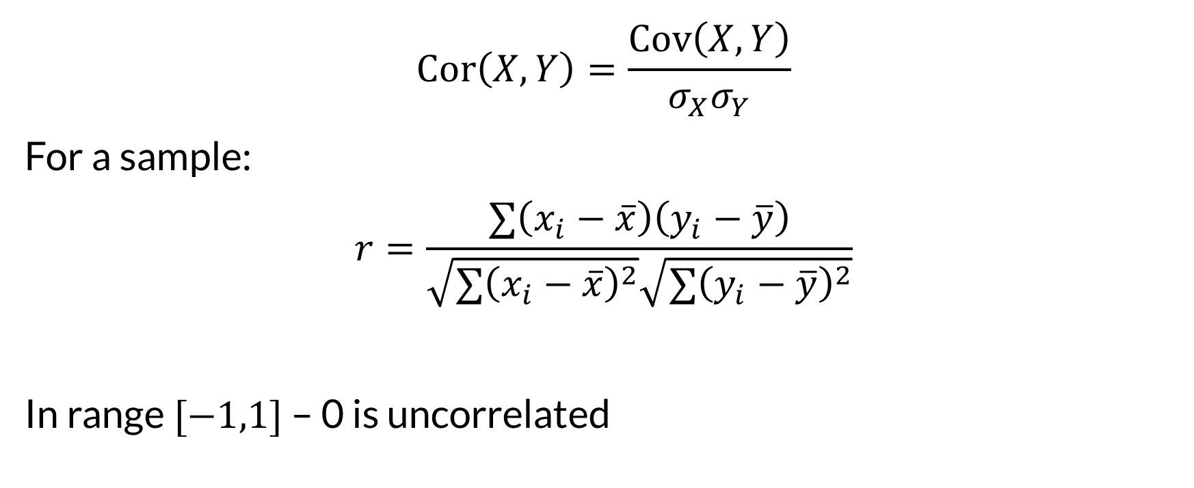
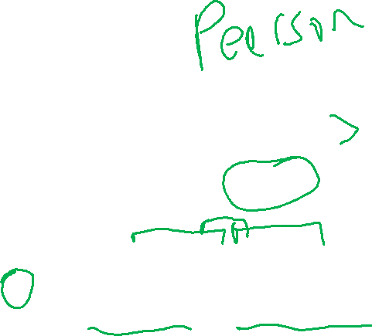
Correlation
$$Cor\left(X,Y\right)=\frac{Cov\left(X,Y\right)}{σ_{X}σ_{Y}}$$
For a sample:
$$r=\frac{∑\left(x_{i}−\overline{x}\right)\left(y_{i}−\overline{y}\right)}{\sqrt{∑{\left(x_{i}−\overline{x}\right)}^{2}}\sqrt{∑{\left(y_{i}−\overline{y}\right)}^{2}}}$$
In range $[−1,1]$ – 0 is uncorrelated

Slide 9
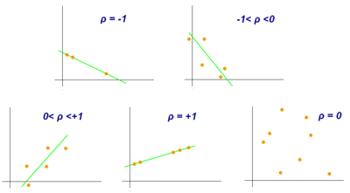

Correlations
Figure from Wikipedia. CC BY-SA 3.0.

Slide 10
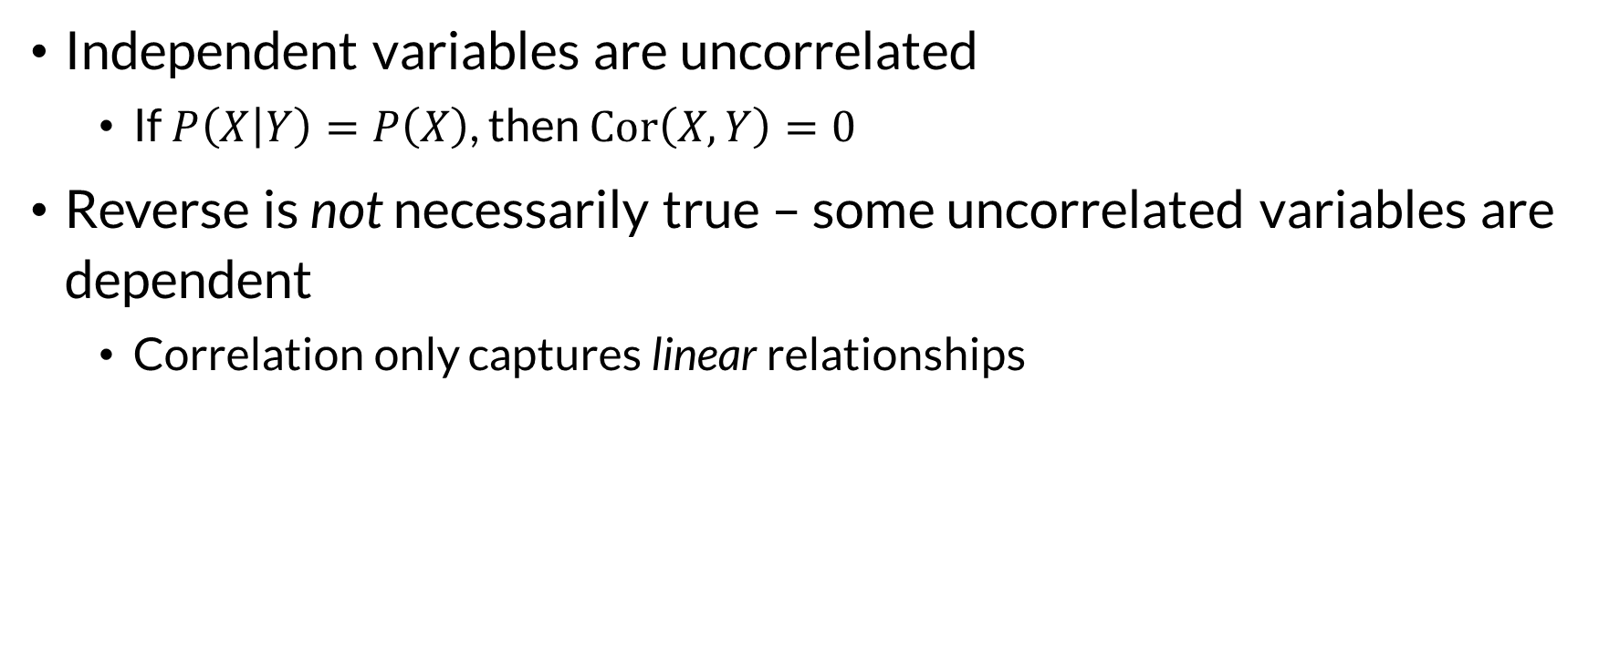

Correlation and Independence
Independent variables are uncorrelated
If $P\left(X | Y\right)=P\left(X\right)$, then $Cor\left(X,Y\right)=0$
Reverse is not necessarily true – some uncorrelated variables are dependent
Correlation only captures linear relationships

Slide 11
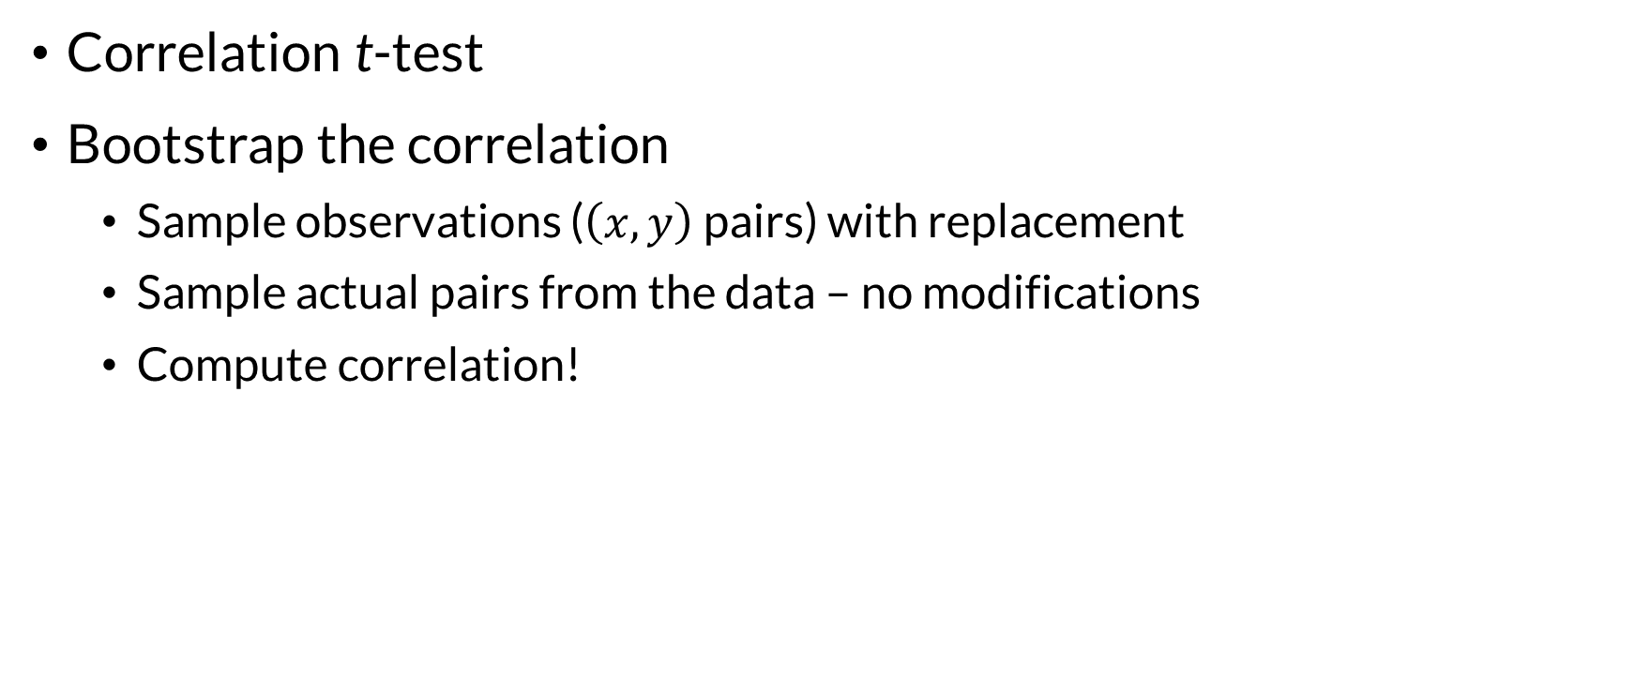
Estimating and Testing
Correlation t-test
Bootstrap the correlation
Sample observations ($\left(x,y\right)$ pairs) with replacement
Sample actual pairs from the data – no modifications
Compute correlation!

Slide 12

Wrapping Up
Correlation measures the degree of linear relationship between two variables.
It is a normalized version of covariance.
Pandas: cov and cor.

